Slide 1

PROJECT-4
SKILL-LYNC
INTERNSHIP
GUIDED BY: MS RAMAYA T
PRESENTED BY: Ms. Sukanya Murugan

Slide 2
MUSICAL DATA ANALYSIS
Objective:
This project involves the analysis of a music playlist database using SQL. By addressing straightforward inquiries, I aim to scrutinize the dataset and provide insights that will assist the store in comprehending its business development.
Data Set: https://drive.google.com/drive/folders/1wnMtcbOx0i4WXdWr29cx5ZYGAnlMZH2X?usp=sharing
There are three set of questions: Easy, Medium and Advance

Slide 3
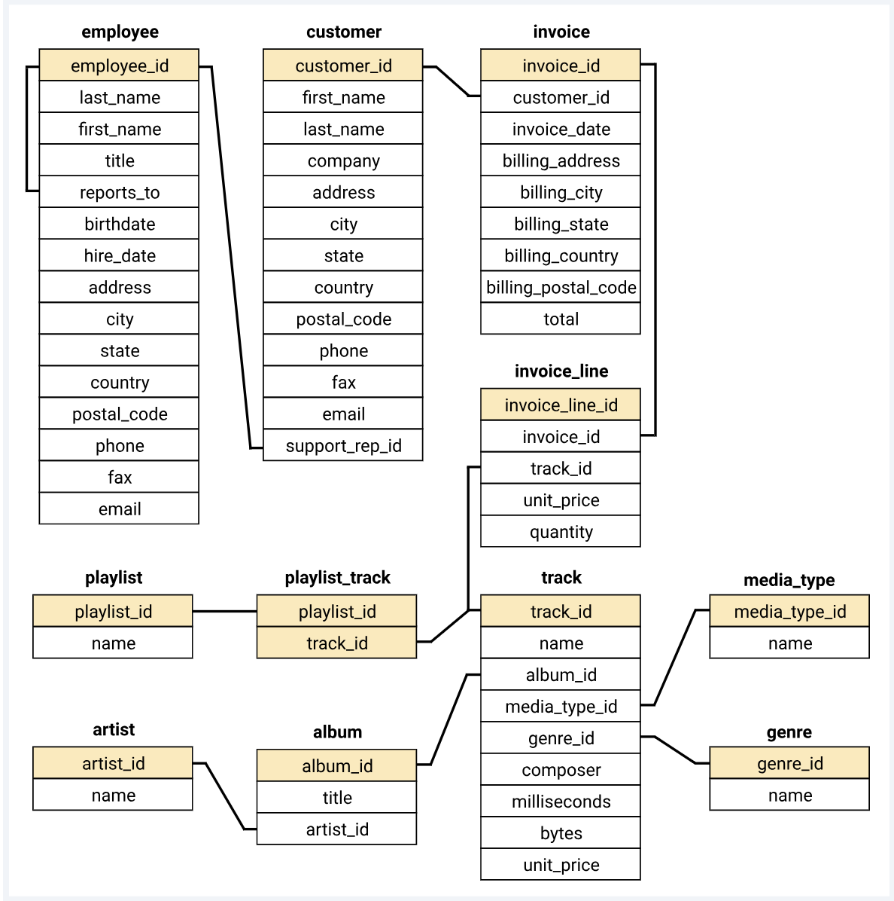
Schema diagram helps in determining the relation between each table.

Slide 4
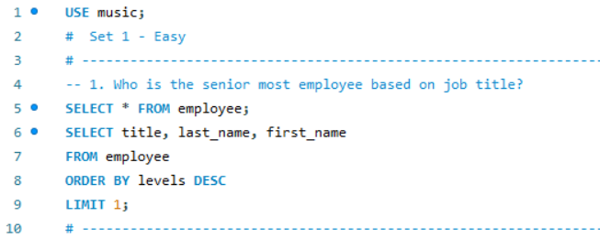
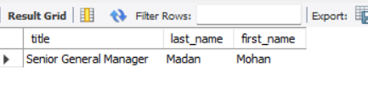
PART I - EASY
Output
Q1Q1.
“ The question aims to determine the most senior employee based on job title. The provided SQL query selects the job title, last name, and first name from the "employee" table, orders the results by job title levels in descending order, and then limits the output to only one result, representing the senior most employee. ”

Slide 5
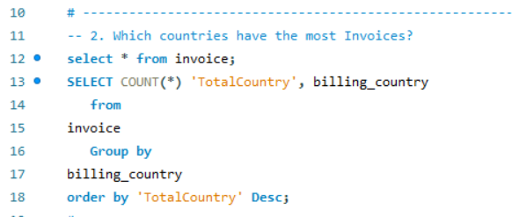
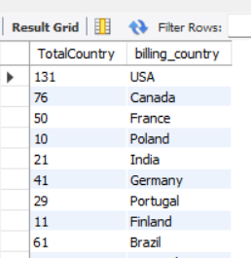
Output
Q1Q2.
“ The question seeks to identify the countries with the highest number of invoices. The accompanying SQL query selects the total count of invoices ('TotalCountry') for each billing country from the "invoice" table, groups the results by billing country, and orders them in descending order based on the total count. ”

Slide 6
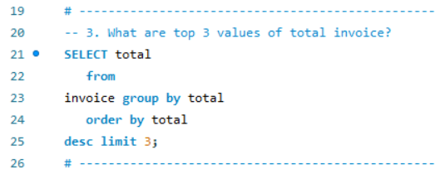
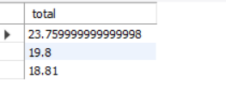
Q1Q3.
Output
“ The question aims to find the top three distinct values of the total invoice amount. The provided SQL query selects the total invoice amounts from the "invoice" table, groups them by total, orders the results in descending order, and limits the output to the top three distinct values. “

Slide 7
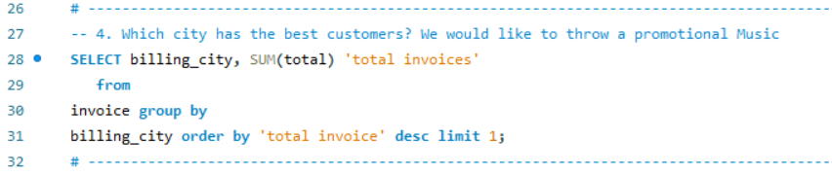

Q1Q4.
Output
“ The question is designed to identify the city with the most valuable customers based on total invoice amounts. The accompanying SQL query selects the billing city and calculates the sum of total invoices for each city from the "invoice" table. The results are then grouped by billing city, ordered in descending order by the total invoice amounts, and limited to the top result, indicating the city with the best customers. “

Slide 8
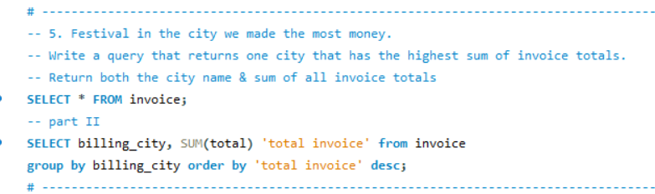
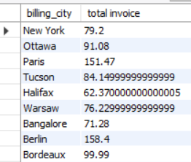
Output
Q1Q5.
“ The question involves identifying the city where the store made the most money and suggesting a festival in that city. The first part of the query selects all columns from the "invoice" table, and the second part calculates the sum of total invoice amounts for each billing city, grouping the results by city, ordering them in descending order based on the total invoice amounts. The top result will indicate the city with the highest sum of invoice totals, suitable for hosting a festival. “

Slide 9
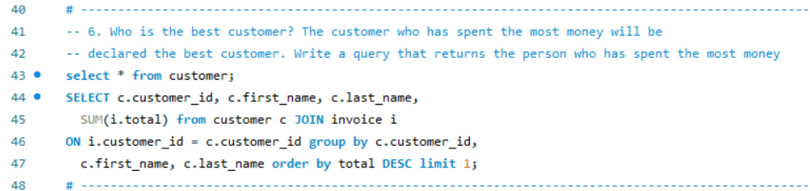
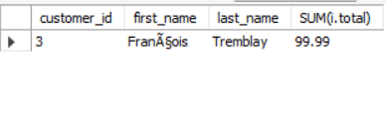
Q1Q6.
Output
“ The question aims to identify the best customer, defined as the person who has spent the most money. The SQL query performs a join between the "customer" and "invoice" tables on the customer_id, calculates the sum of total invoice amounts for each customer, and then selects the customer_id, first_name, last_name, and the total spent. The results are grouped by customer_id, first_name, and last_name, ordered in descending order based on the total spent, and limited to the top result, indicating the customer who has spent the most money. “

Slide 10
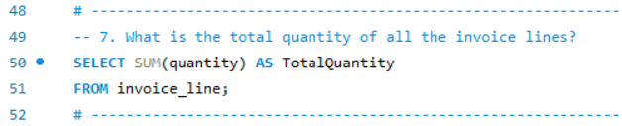
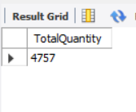
Q1Q7.
Output
“ The question seeks to determine the total quantity of all the invoice lines. The provided SQL query calculates the sum of the "quantity" column from the "invoice_line" table and aliases it as "TotalQuantity." The result will represent the cumulative quantity of all the invoice lines. “

Slide 11
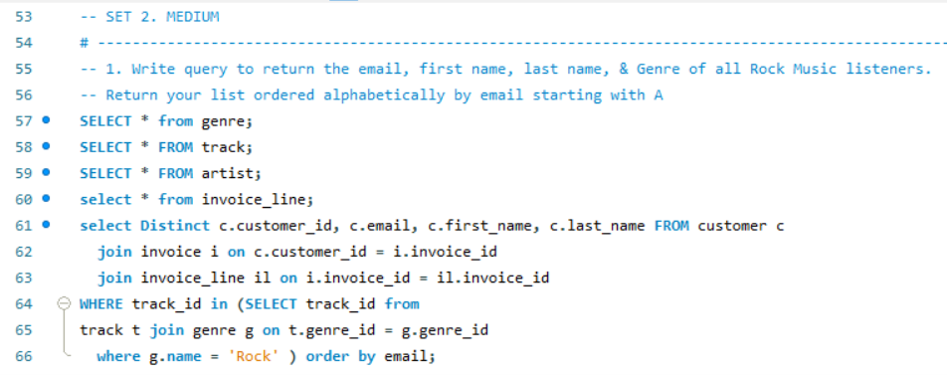
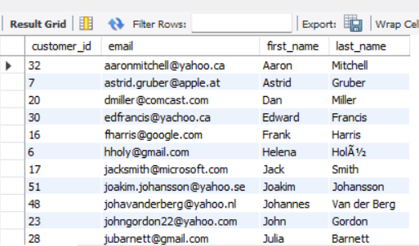
PART II - MEDIUM
Output
Q1Q1.
“ The query retrieves a list of unique customers who have purchased Rock music, including their customer ID, email, first name, last name, and the genre of the purchased tracks. It involves multiple joins between the "customer," "invoice," "invoice_line," "track," and "genre" tables based on relevant keys. The results are filtered to include only Rock music listeners and are ordered alphabetically by email. “

Slide 12
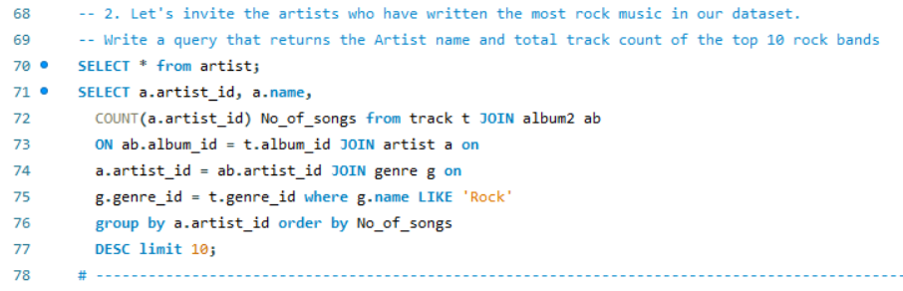
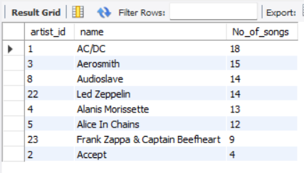
Q1Q2.
Output
“ The query retrieves information about the top 10 artists who have contributed the most songs in the Rock genre. It involves joining the "track," "album2," "artist," and "genre" tables based on their respective keys. The results are filtered to include only Rock genre tracks, grouped by artist ID, and then ordered in descending order based on the number of songs contributed by each artist. The limit is set to display only the top 10 artists. “

Slide 13
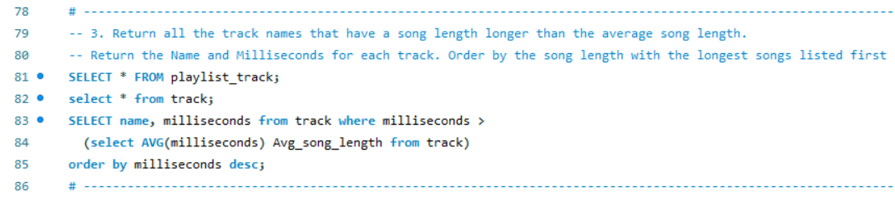
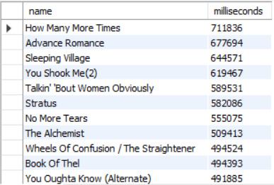
Q1Q3.
Output
“ This query selects the names and durations (in milliseconds) of tracks that have a duration longer than the average duration of all tracks. It employs a subquery to calculate the average song length from the "track" table and then selects tracks with durations exceeding this average. The results are ordered in descending order based on track duration. “

Slide 14
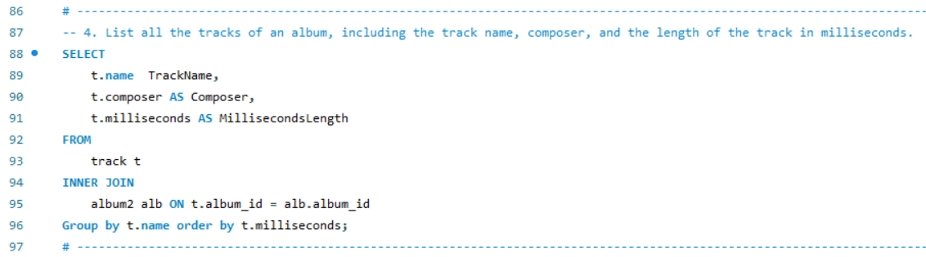
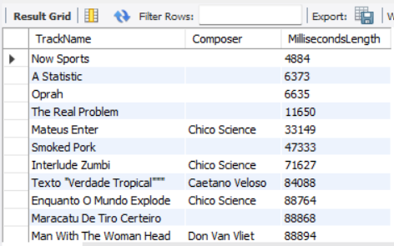
Q1Q4.
Output
“ This query retrieves information from the "track" table, specifically the track name (`TrackName`), composer (`Composer`), and duration in milliseconds (`MillisecondsLength`). It uses an inner join with the "album2" table on the album_id. The results are then grouped by track name and ordered by the track duration in ascending order. Note that when using `GROUP BY`, it's common to include aggregate functions (like `SUM`, `COUNT`, etc.), but in this case, it seems to be grouping by the track name without any aggregation, which might lead to unexpected results. “

Slide 15
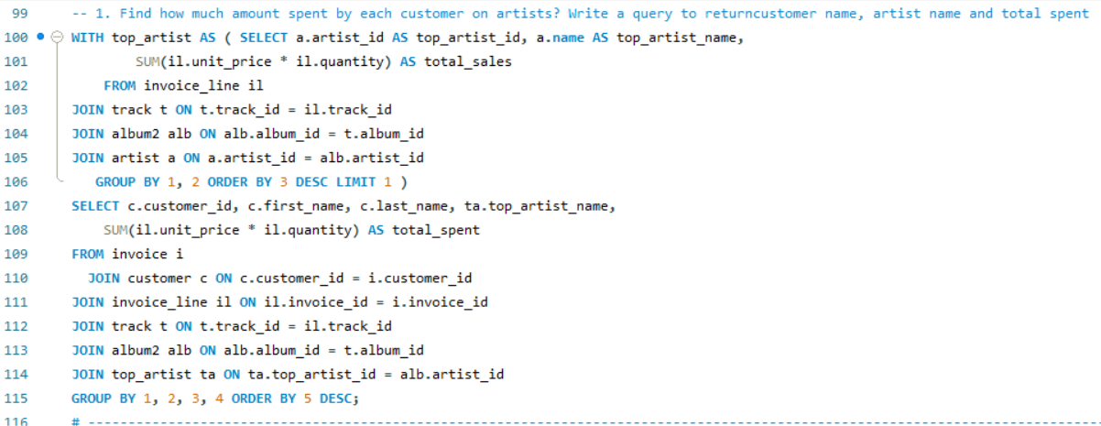
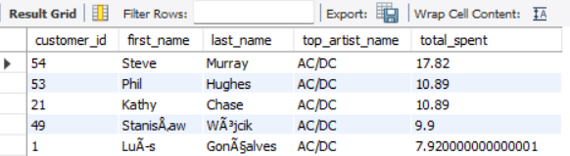
PART II - ADVANCE
Q1Q1.
Output
“ This query uses a Common Table Expression (CTE) named `top_artist` to identify the top-selling artist based on total sales. It then retrieves customer information, including customer ID, first name, last name, and the top artist's name. The results are aggregated by customer and ordered by the total amount spent on the top artist's tracks in descending order. “

Slide 16
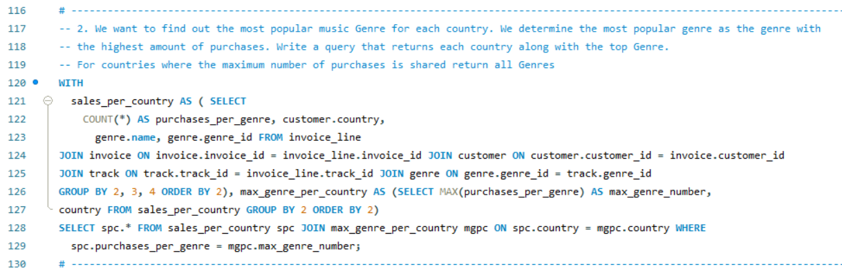
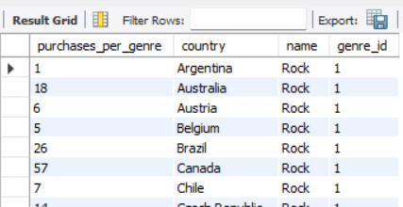
Q1Q2.
Output
“ This query utilizes two Common Table Expressions (CTEs) named `sales_per_country` and `max_genre_per_country` to find the most purchased genre in each country. The first CTE calculates the count of purchases per genre in each country, and the second CTE identifies the maximum genre count per country. The final SELECT statement then combines the two CTEs, showing the genre sales information for each country where it matches the maximum genre count. “

Slide 17
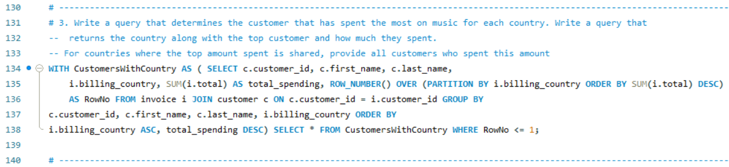
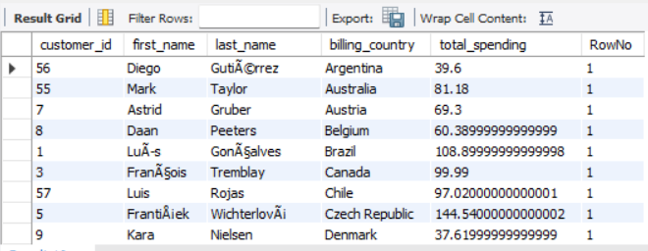
Q1Q3.
Output
“ This query employs a Common Table Expression (CTE) named `CustomersWithCountry` to identify customers with the highest total spending in each billing country. It calculates the total spending for each customer in each country, assigns a row number based on the descending order of total spending within each country, and then selects the customers where the row number is 1 (indicating the highest spender in each country). The final result displays customer details, billing country, total spending, and is sorted by billing country and total spending in descending order. “

Slide 18
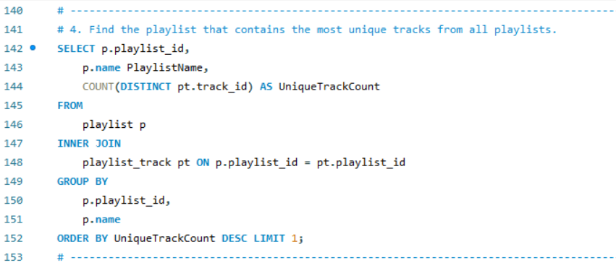
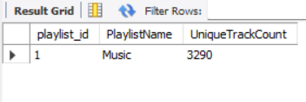
Output
Q1Q4.
“ This query retrieves information about playlists, specifically the playlist ID (`playlist_id`), playlist name (`PlaylistName`), and the count of unique tracks in each playlist (`UniqueTrackCount`). It uses an inner join with the "playlist_track" table based on the playlist ID. The results are then grouped by playlist ID and name, ordered in descending order by the count of unique tracks, and limited to the top result (playlist with the highest unique track count). “

Slide 19
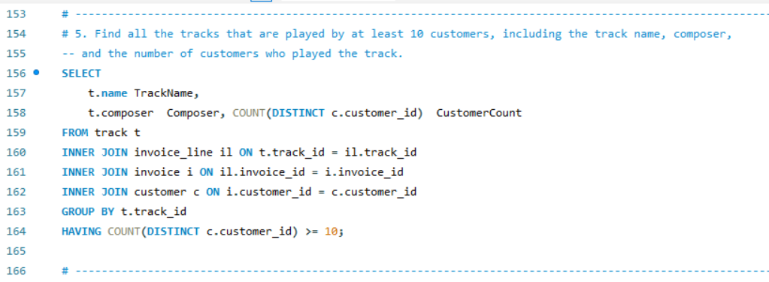
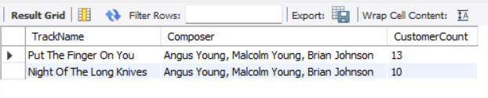
Q1Q5.
Output
“ This query retrieves information about tracks, including the track name (`TrackName`), composer (`Composer`), and the count of distinct customers who have purchased each track (`CustomerCount`). It involves inner joins with the "invoice_line," "invoice," and "customer" tables based on relevant keys. The results are then grouped by track ID, and the HAVING clause filters the results to include only tracks with 10 or more distinct customers who have purchased them. “

Slide 20
THANK YOU!

